Slide 1


PLANT CARE
Analysis
Name : Prajapati Kisha Mehulbhai

Slide 2
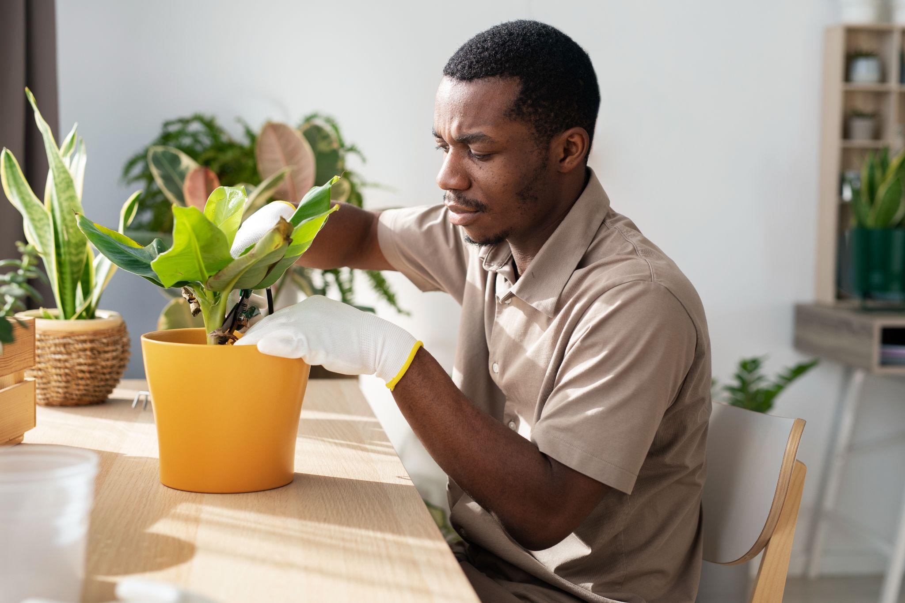
INTRODUCTION
Plants play a vital role in maintaining ecological balance, providing oxygen, and enhancing human well-being. However, proper plant care requires an understanding of growth patterns, soil conditions, and environmental factors. Plant Care Analysis using Python is an interactive tool designed to assist users in monitoring plant health.

Slide 3
TECHNOLOY USED
Python
Streamlit
Pandas & Matplotlib
Dataset
TECHNOLOY USED
Backend processing.
Interactive web-based UI
Provides structured plant care data
Data analysis & visualization

Slide 4
KEY FEATURES
Search & Filter Functionality
A search bar at the top to enter a plant name.
Filters images based on the entered plant name for access.
Data-Driven Insights Using Dataset
Uses datasets to analyze plant health.
Provides charts and visualizations for better understanding
Analysis Based on :
Identifies yellow, brown, or drooping leaves to detect issues.
Provides recommendations for healthy plant yield.

Slide 5
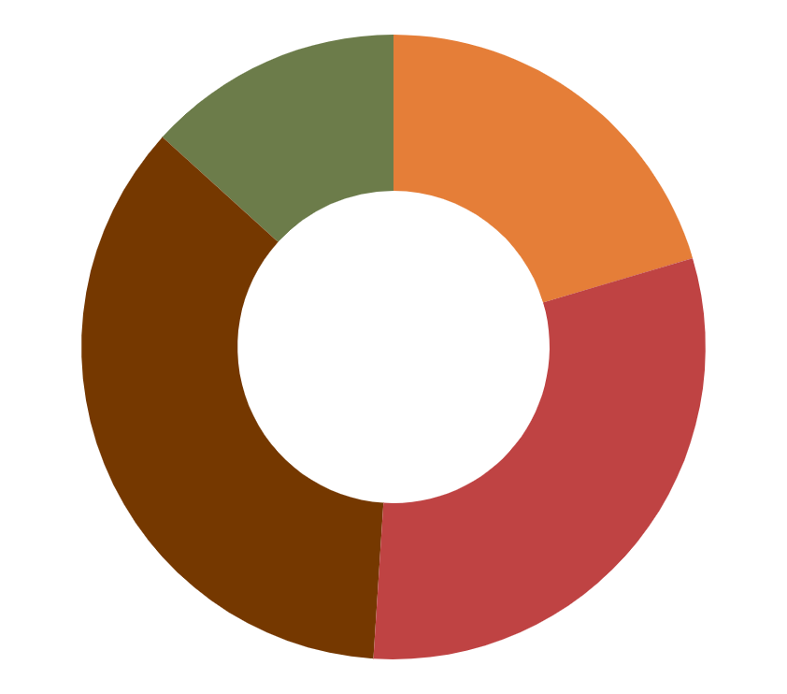
MERITS
DEMERITS
Environmental Benefits:
  Healthy plants contribute to better air quality, soil health, and ecosystem balance.
Educational Value:
Helps gardeners and plant enthusiasts learn more about plant biology and care requirements.
Prevents Diseases and Pests:
  Early detection of issues like nutrient deficiencies or overwatering can prevent diseases and pest infestations.
Limited by Plant Type:
  Some plants are hardier and may not require detailed analysis, making the process unnecessary for certain species.
Risk of Over-Management:
  Excessive tinkering with plant conditions (e.g., over-fertilizing or over-pruning) can harm plants.
Not Always Accurate:
  Tools like moisture meters or soil testers may sometimes provide inaccurate readings, leading to incorrect care decisions.

Slide 6
FUTURE SCOPE
AI-Based Plant Disease Detection | Use CNN (Convolutional Neural Networks) for image classification. Provide real-time disease diagnosis and suggest treatments.
Automated Growth Prediction Models | Develop predictive models using historical plant data.
Mobile App Version | Create a mobile-friendly version using Flutter or React Native. Allow users to scan plant leaves for instant health reports
Community & Social Features | Enable user discussions and Q&A forums for plant care tips. Users can share their plant growth journey with pictures and progress updates.

Slide 7

THANK YOU

